Slide 1


Diabetes Prediction and Analysis by
Rithika- pes2ug20cs528
Neeraja-pes2ug20cs539
Sumeda-pes2ug20cs562

Slide 2


CONTENTS
Problem Statement
About Dataset
Approach
ML Models
Evaluation
Conclusion

Slide 3
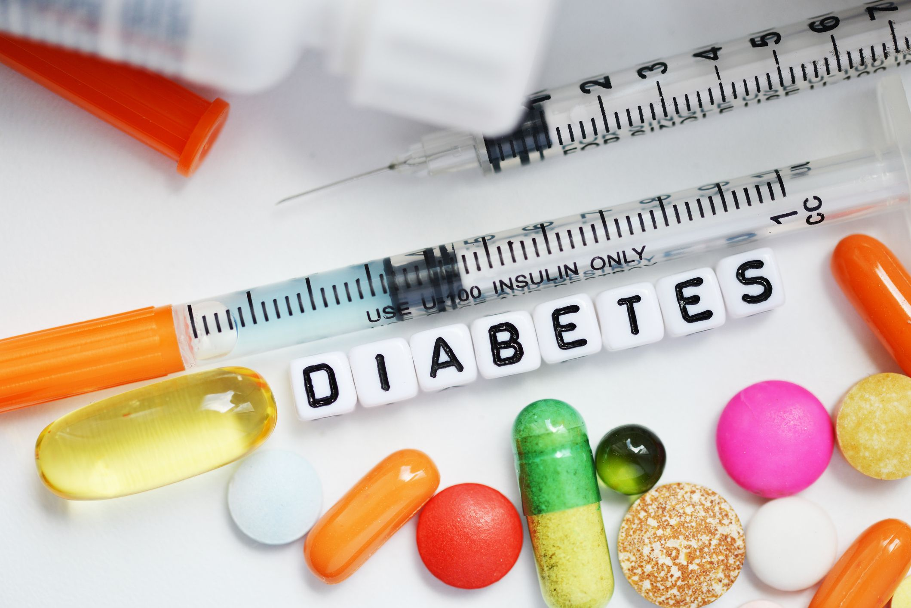
Problem Statement
To predict if an individual has diabetes or not based on his vitals and to identify the better model to do so.

Slide 4
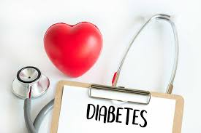
Application And Use
Diabetics prediction has the following the applications:
Hospitals
Researchers
Improved Treatment
Early Detection
Pharmacy

Slide 5
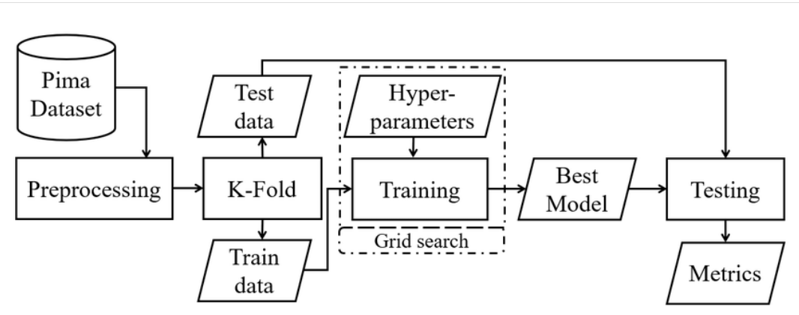
Architecture

Slide 6
Literature Review
Title of paper | Year published | Author | Advantages | Limitations
Diabetes Prediction using Machine Learning Algorithms | 2016 | Aishwarya Mujumdar, Dr. V Vaidehi | As external factors responsible for diabetes along with regular factors like Glucose, the accuracy of the classification model is increased | It is harder to collect and maintain the larger database.
Diabetes Prediction Using Ensembling of Different Machine Learning Classifiers | 2020 | Md. Kamrul Hasan, Md. Ashraful Alam | A robust framework where the outlier rejection, filling the missing values, data standardization and different Machine Learning classifiers were employed, Thus improving accuracy. | High processing power required to use this model limits the usage to few systems powerful enough.
Diabetes Prediction Using Machine Learning Techniques | 2018 | Tejas N. Joshi, Prof. Pramila M. Chawan | The ensembling of two boosting type classifiers is the best combination for diabetes prediction, as the base classifiers should have a minimum correlation between them. | The accuracy is less comparatively..

Slide 7
About Dataset
The data was collected and made available by “National Institute of Diabetes and Digestive and Kidney Diseases” as part of the Pima Indians Diabetes Database. Several constraints were placed on the selection of these instances from a larger database. In particular, all patients here belong to the Pima Indian heritage (subgroup of Native Americans), and are females of ages 21 and above.
The dataset consist of the attribute as follows : Pregnancies, Glucose, Blood Pressure, Skin Thickness, Insulin, BMI, Diabetes Pedigree Function, Age and outcome.
Dataset Link : https://www.kaggle.com/datasets/nancyalaswad90/review

Slide 8
Approach
We have used Python and some of its popular data science related packages. To start off we imported pandas to read our data from a CSV file and manipulate it for further use. To convert out data into a format suitable to feed our classification model, we used numpy. Seaborn and matplotlib are used for visualizations. We then import Logistic Regression algorithm and Support Vector machine algorithm from sklearn. This algorithm will help us build our classification model.

Slide 9
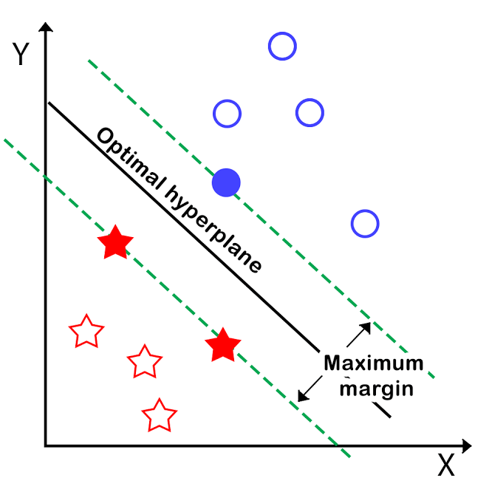
ML Models
SUPPORT VECTOR MACHINE
SVM or Support Vector Machine is a linear model for classification and regression problems. It can solve linear and non-linear problems and work well for many practical problems. The idea of SVM is simple: The algorithm creates a line or a hyperplane which separates the data into classes.

Slide 10
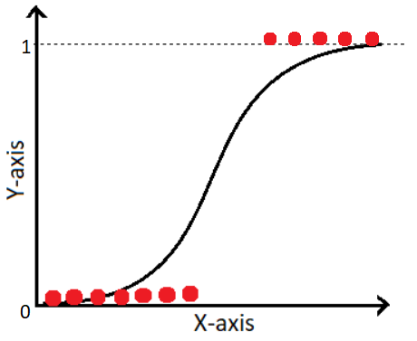
ML Models
LOGISTIC REGRESSION
Logistic regression is a statistical analysis method to predict a binary outcome, such as yes or no, based on prior observations of a data set. A logistic regression model predicts a dependent data variable by analyzing the relationship between one or more existing independent variables.

Slide 11
Evaluation
LOGISTIC REGRESSION
SUPPORT VECTOR MACHINE
Training data accuracy is 76.95%
Testing data accuracy is 82.97%
Training data accuracy is 77.30%
Testing data accuracy is 82.26%

Slide 12
Conclusion
We can use either of Support Vector Machine model or Logistic Regression model, To predict whether a person is diabetic or not, as both of them have performed similarly when it comes to accuracy.
Hence we recommend hospitals to use our model for early diagnosis of diabetes in patients.

Slide 13
References
Gauri D. Kalyankar, Shivananda R. Poojara and Nagaraj V. Dharwadkar,” Predictive Analysis of Diabetic Patient Data Using Machine Learning and Hadoop”, International Conference On I-SMAC, 978-1-5090-3243-3, 2017.
  Ayush Anand and Divya Shakti,” Prediction of Diabetes Based on Personal Lifestyle Indicators”, 1st International Conference on Next
  Generation Computing Technologies, 978-1-4673-6809-4, September 2015.
  B. Nithya and Dr. V. Ilango,” Predictive Analytics in Health Care Using Machine Learning Tools and Techniques”, International Conference on
  Intelligent Computing and Control Systems, 978-1-5386-2745-7, 2017.

Slide 14

THANK YOU

